Slide 1
Eksplorasi WSO2 BPS dan JBPM
Kelompok Alfresco
13509085 - Andre Novelando
13511026 – Akbar Juang Saputra
13512030 – Alvin Natawiguna
18211031 – Nicolas Novian Ruslim
13511078 – Taufik Hidayat

Slide 2
WSO2 BPS
WSO2 Business Process Server (BPS) is an easy-to-use Business Process Server that executes business processes written following WS-BPEL standard.
WS-BPEL is emerging as the de facto standard for composing multiple synchronous and asynchronous web services into collaborative and transactional process flows which increase the flexibility and agility of your service-oriented architecture.

Slide 3
WSO2 BPS
WSO2 BPS is powered by Apache ODE (Apache Orchestration Director Engine).
WSO2 BPS provides a complete Web-based graphical console to deploy, manage and monitor business process and process instances.

Slide 4
WSO2 BPS Features
Define and Execute Business Processes
Data Manipulation & Extensibility
Define Workflows Interacting with People
Create & Monitor Custom Key Performance Indicators (KPIs)
Graphical Process Modeling
Process Management via Graphical Administration Console
Integrates to Existing Environment
High Availability, Scalability and Stability
Lightweight, Developer Friendly and Easy to Deploy
Manage & Monitor

Slide 5
JBoss jBPM
JBoss jBPM is a workflow, process automation, that enables coordination between disparate applications and services, resulting in the deployment of new revenue generating business processes

Slide 6
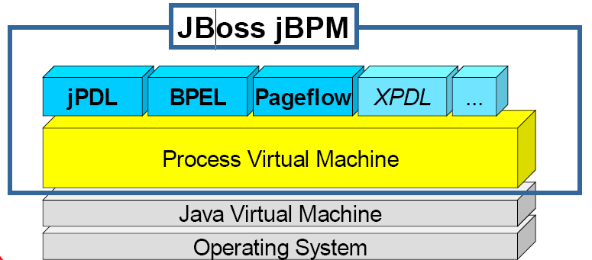
Architecture Jboss jBPM
JBoss Enterprise Framework that delivers workflow, business process management (BPM) and service orchestration in a multi-process language platform and in a scalable and flexible product footprint.

Slide 7
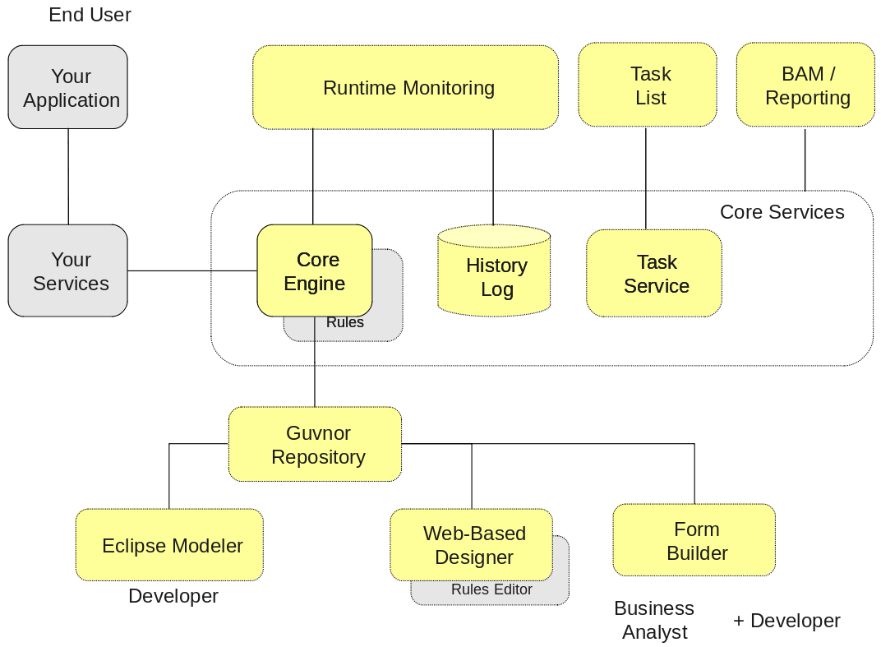
jBPM Overview
The grey boxes show the component that are not part of jBPM project with which jBPM can integrate.
The dashed border indicates the optional component, while the core engine is the core of the project and is required if you want to execute business processes.

Slide 8
jBPM Overview
The history log will log all information about the current and previous state of all your process instances.

Slide 9
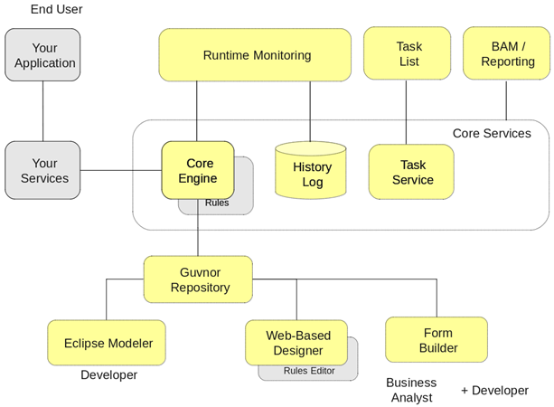
jBPM Overview
The human task service will take care of the human task life cycle if human actors participate in the process.

Slide 10
jBPM Overview
The Guvnor repository is an optional component that can be used to store all your business processes. It supports collaboration, versioning, etc.

Slide 11
jBPM Overview
The web-based designer is integrated in the Guvnor repository, which is targeted towards business users and allows you to manage your processes separately from your application.

Slide 12
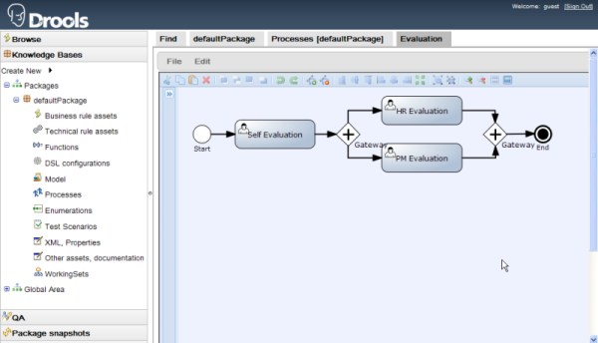
jBPM Overview
The web-based designer is integrated in the Guvnor repository, which is targeted towards business users and allows you to manage your processes separately from your application.

Slide 13
jBPM Overview
Business processes can be managed through a web-based management console.
It is targeted towards business users and its main features are:
Runtime monitoring (Process Instance Management)
Task list (Human Task Management)
Business Activity Monitoring (BAM) and Reporting

Slide 14
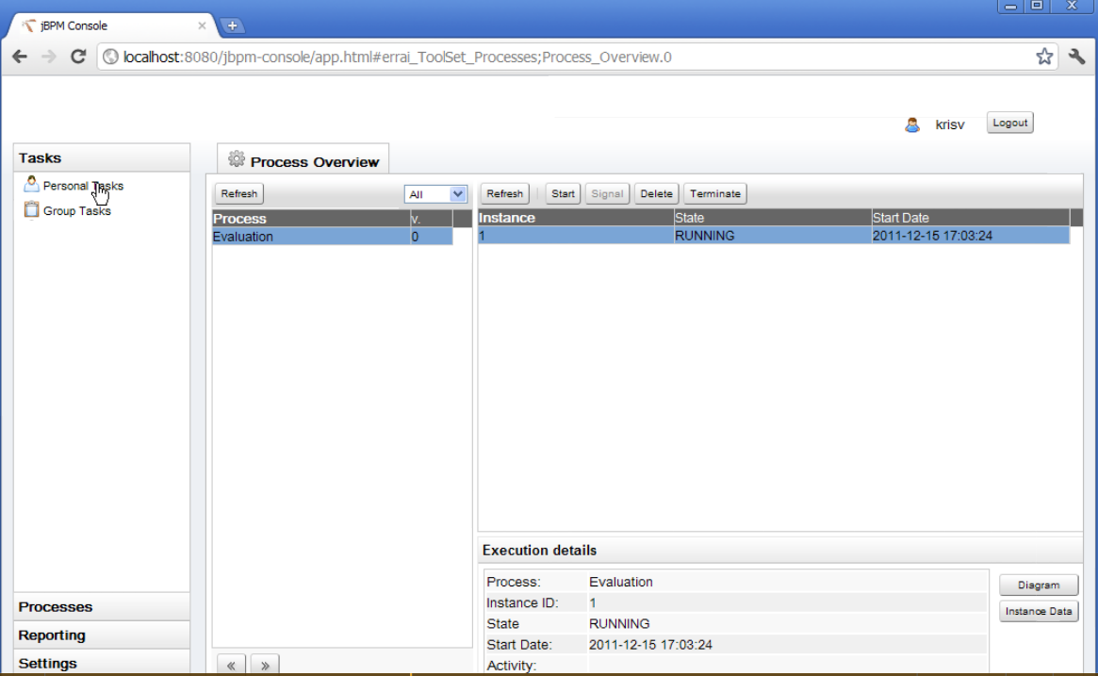
jBPM Overview

Slide 15
jBPM Overview
A web-based form builder allows you to create, generate and/or edit your form (both for starting a process or completing a user task) using a WYSIWYG editor.

Slide 16
References
www.egjug.org/files/Introducing%20JBPM.ppt
http://wso2.com/products/business-process-server/
http://www.jbpm.org/
http://docs.jboss.org/jbpm

